Slide 1
Disclaimer
These slides are intended as presentation aids for the lecture. They contain information that would otherwise be to difficult or time-consuming to reproduce on the board. But they are incomplete, not self-explanatory, and are not always used in the order they appear in this presentation. As a result, these slides should not be used as a script for this course. I recommend you take notes during class, maybe on the slides themselves. It has been shown that taking notes improves learning success.

Slide 2
Reading for this set of slides
Craig – Intro to Robotics (3rd Edition)
Chapter 5 (5.1 – 5.10)
Please note that this set of slides is intended as support for the lecture, not as a
stand-alone script. If you want to study for this course, please use these slides
in conjunction with the indicated chapters in the text books. The textbooks are
available online or in the TUB library (many copies that can be checked out for the entire semester. There are also some aspects of the lectures that will not be
covered in the text books but can still be part of the homework or exam. For those
It is important that you attend class or ask somebody about what was covered in class.

Slide 3
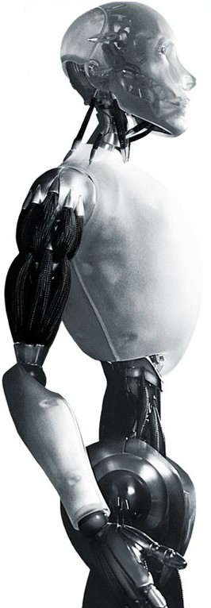
Robotics The Jacobian Matrix
TU Berlin
Oliver Brock
TexPoint fonts used in EMF.
Read the TexPoint manual before you delete this box.: AAAAAAAAAAAAA

Slide 4
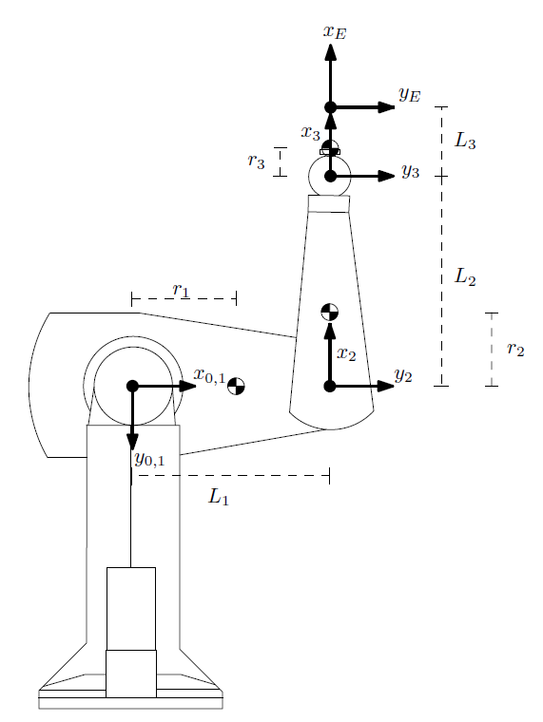
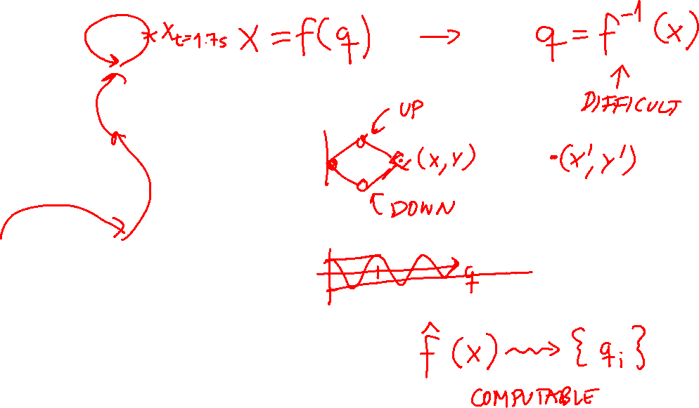
Notes:
Forward: Where is the end-effector based on a given configuration?
Inverse: Where do the joints have to be to place the end-effector? (We did not cover this yet)
Now: How does joint motion and end-effector motion relate?
before, we considered static configurations
we start to consider linear and angular velocities, as well as static forces
2 tricks: 1) localize 2) linearize

Slide 5
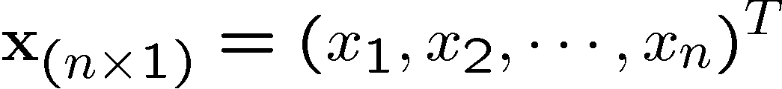
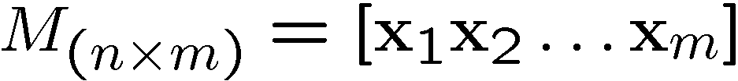

Notation
To make equations more readable we will adopt the following:
Vector:
Matrix:
Derivative of vectors and matrices:
We’ll introduce more as we go along…

Slide 6
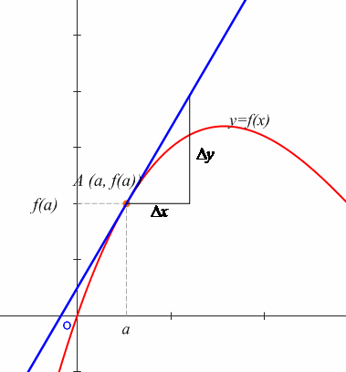
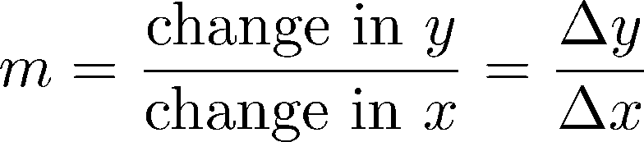
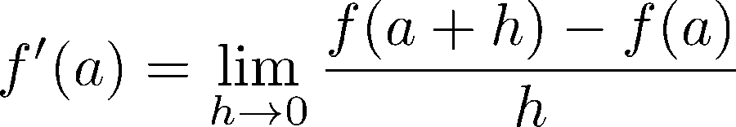
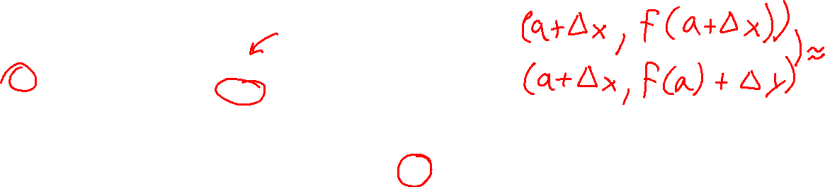
Warm-Up: Derivative
Notes:
http://thecalculuspage.com/images/derivativegraph1.jpg

Slide 7
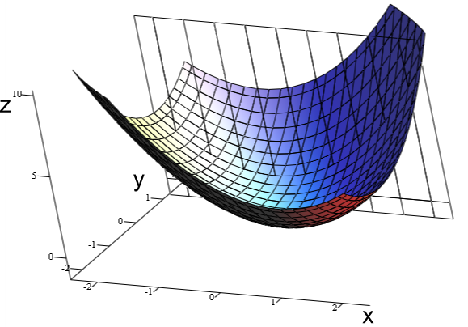
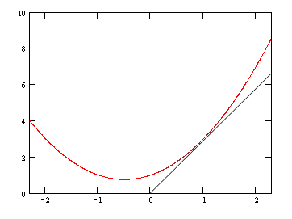
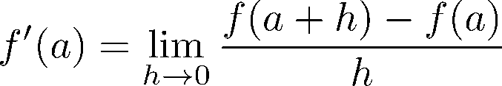
Warm-Up: Partial Derivative

Slide 8
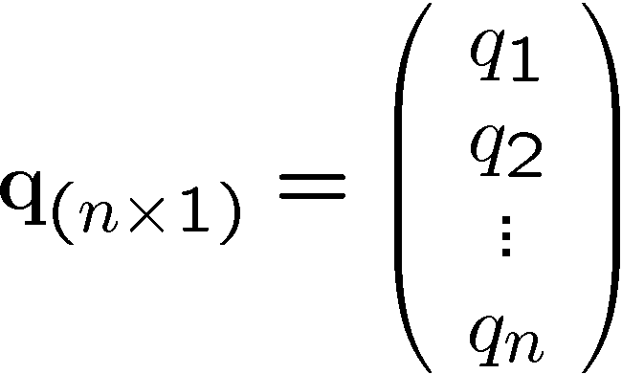
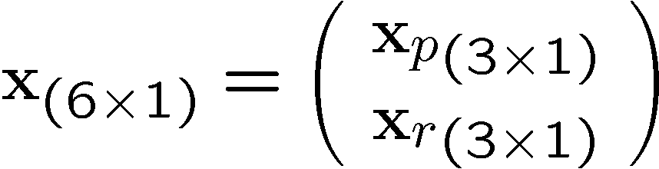
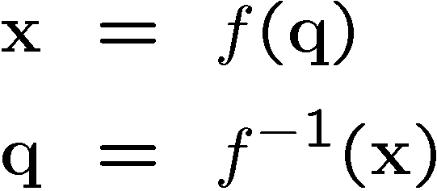

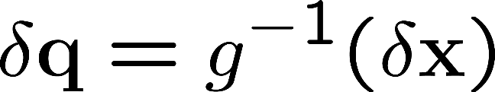


Infinitesimal Change and Velocities

Slide 9
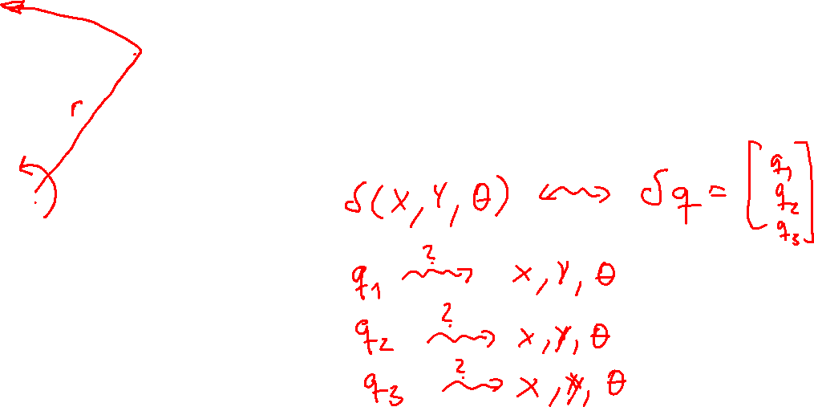
What is the relationship between velocities?
Notes:
All joints contribute to all elements of the description of the end-effector (x,y,theta)

Slide 10
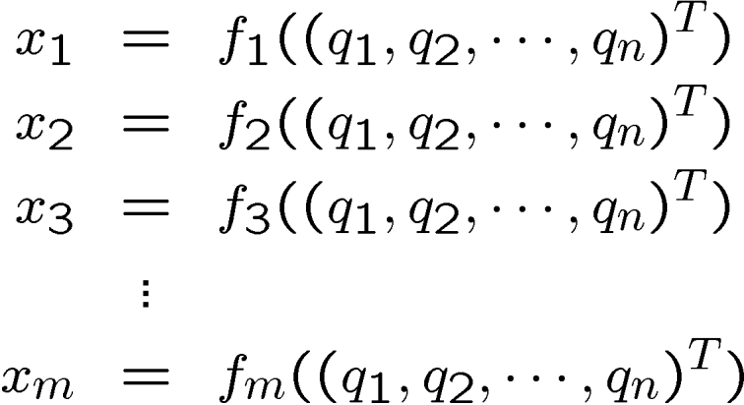
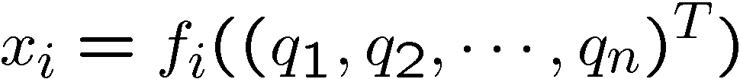
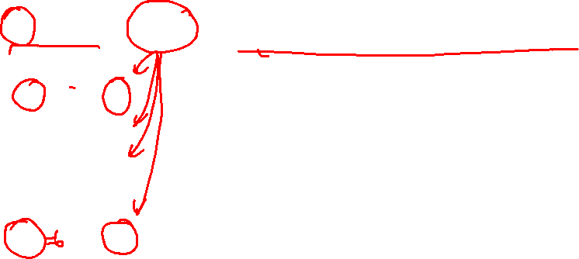
Rewriting Forward Kinematics

Slide 11
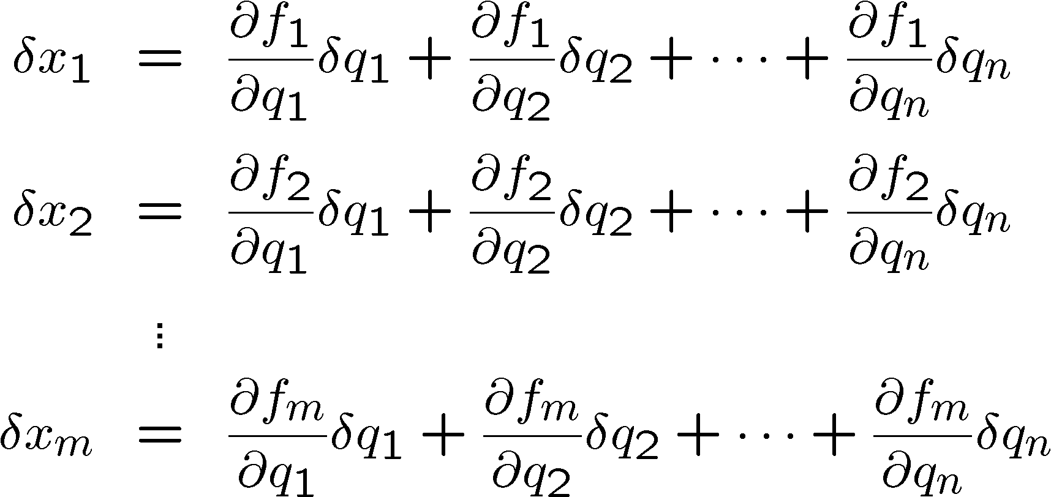
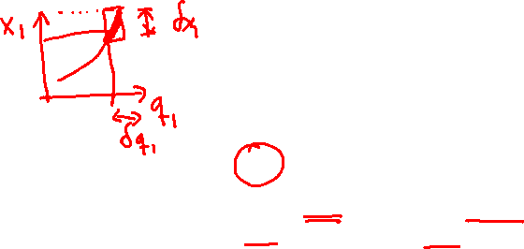
How does the end-effector move?

Slide 12
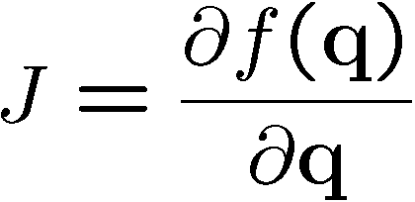
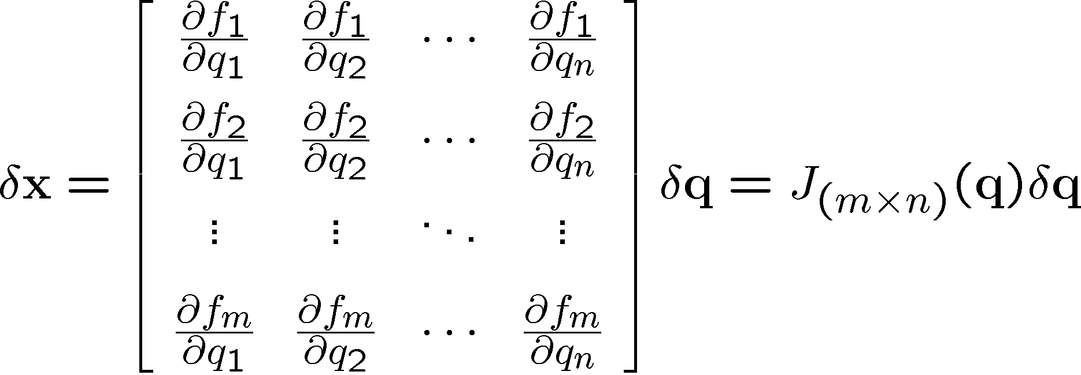
The Jacobian Matrix

Slide 13
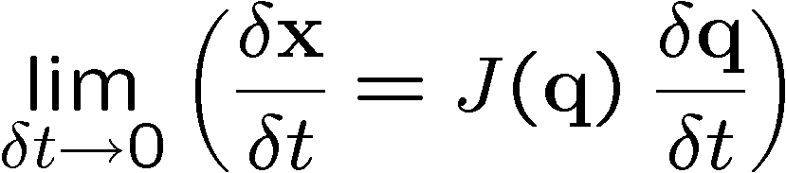

Jacobian and Velocities

Slide 14

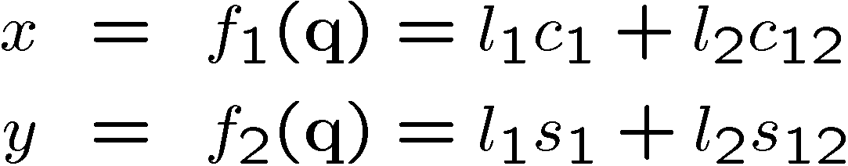


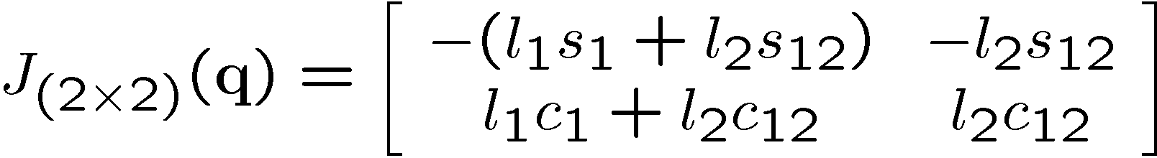
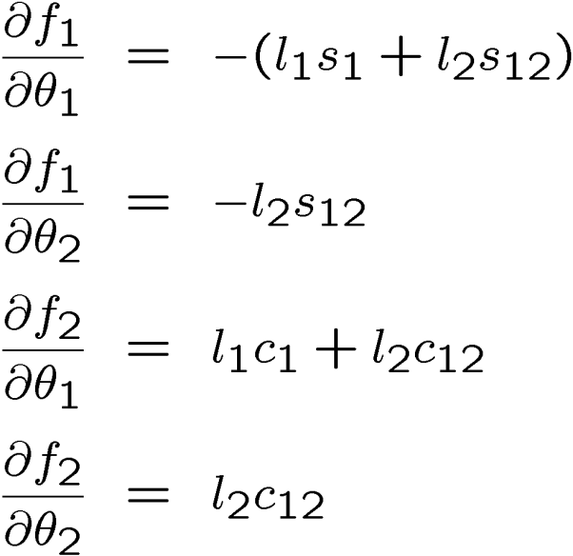
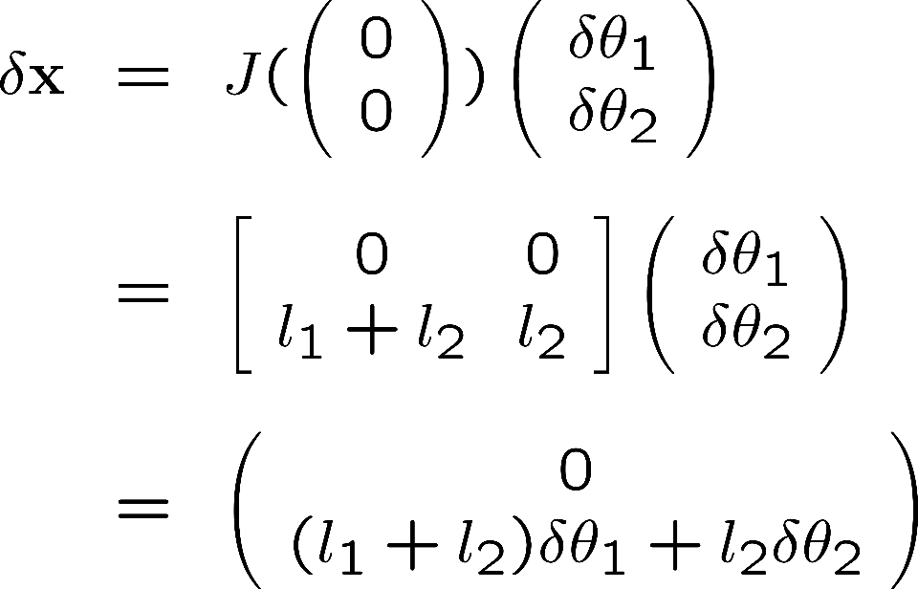
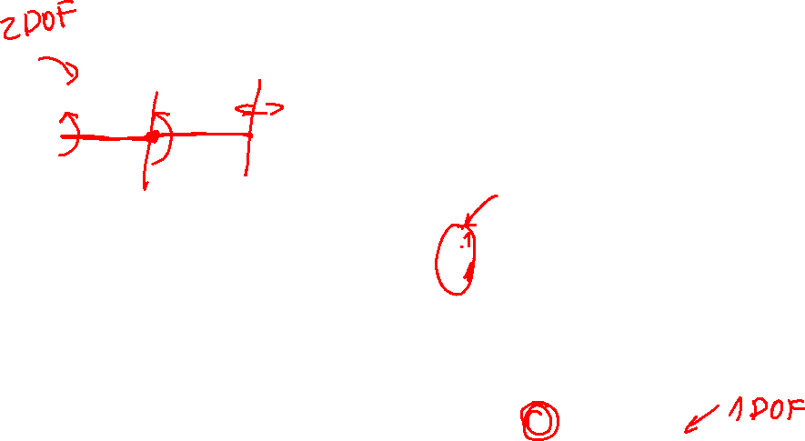
Jacobian: Example
Reminder:

Slide 15

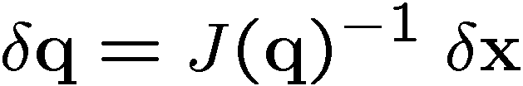
What the Jacobian can do…

Slide 16

Notes:
Illustrate what happens when a 2DOF rotational robot arm loses 1 DOF
Background image
https://www.pexels.com/photo/background-black-blackboard-board-159770/

